Slide 1
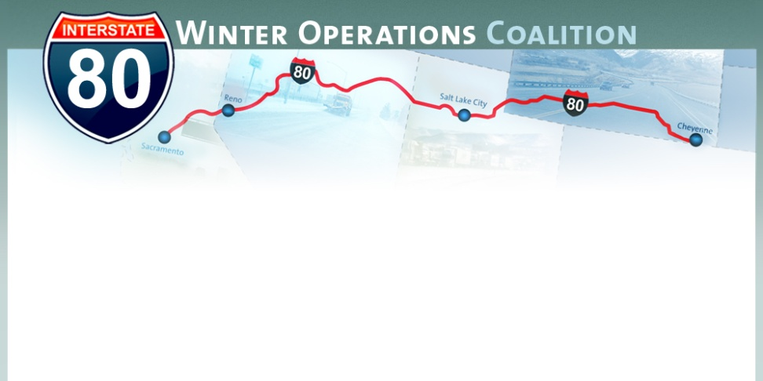
Interstate-80 Winter Operations Coalition
Jim McGee MPA
September 25, 2012
Reno, NV

Slide 2
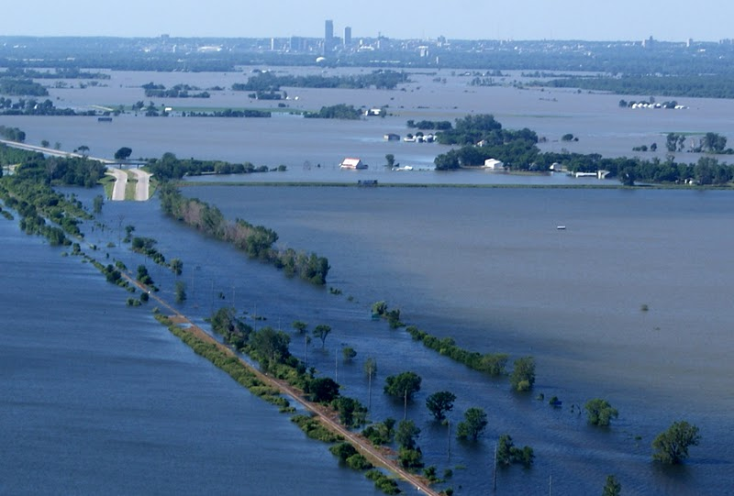
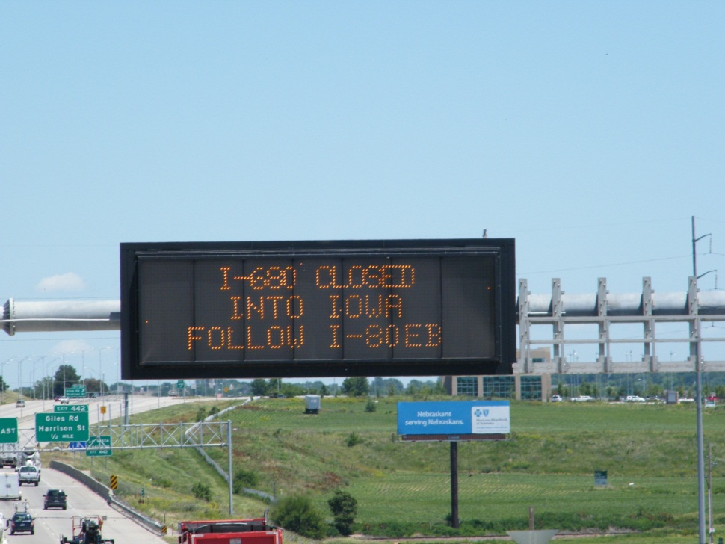


Rural Traffic Incident Management Training in Nebraska
Jim McGee MPA
Nebraska DOR
October 16, 2012
Changing Traffic Incident Management by Training a Nation of Responders…

Slide 3
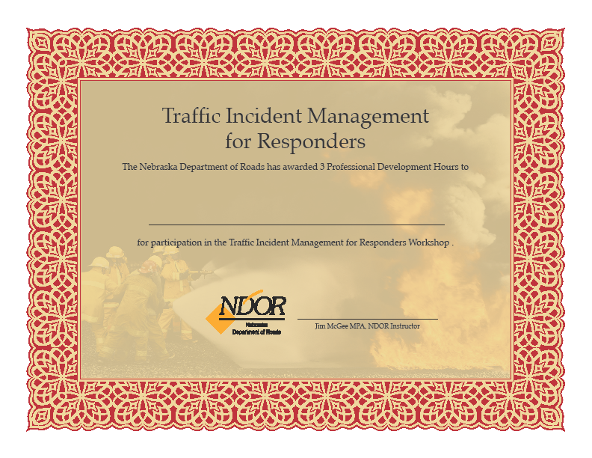
Nebraska Traffic Incident Management for Responder Workshops
Ogallala, Thedford, North Platte, Hershey, Plattsmouth, Bennington, Municipal Fire Chiefs, Nebraska Fire School, Training Academies, NDOR, UN-Omaha

Slide 4
What are TIM core competencies?
SHRP 2 National TIM Responder Training
Primary core competencies:
Those shared or similar actions typically taken by at least three on-scene responder groups.
Every incident responder active in that incident management phase—regardless of responder type—should know how to implement these core competencies.
Using emergency responder vehicles to create a safe work area scene and wearing appropriate high-visibility protective apparel are primary core competencies.
Secondary core competencies:
Those actions that a specific responder group performs that all other responder groups should understand and be aware of.
These competencies are interdependent.
Individual responders may not need to know how to actually implement them.
Discipline-specific competencies:
Those that only one responder group performs are of such a critical nature that it is necessary for all disciplines to be aware of their existence and performance
Hazardous materials (hazmat) cleanup is an example

Slide 5
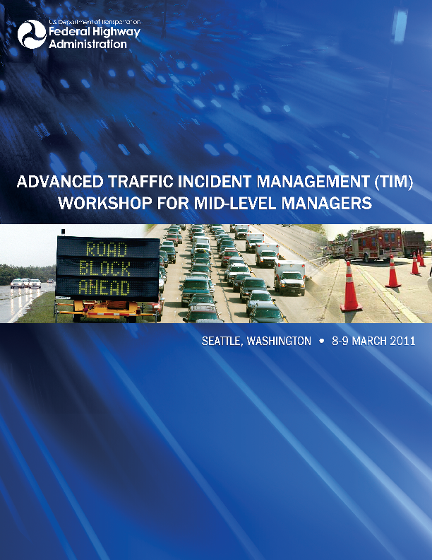

FHWA
TIM Workshop for Mid-Level Managers, SHRP-2
Changing Traffic Incident Management by Training a Nation of Responders…
SHRP 2 National TIM Responder Training
Paul Jodoin
Federal Highway Administration

Slide 6

1091 Standard for Traffic Control Incident Management Professional Qualifications
The draft NFPA standard identifies the minimum job performance requirements (JPRs) necessary to perform Temporary Traffic Control (TTC) duties at emergency incidents at or near an active roadway.

Slide 7

NRF
Key Documents in National Response Framework (NRF):
NRF:
Delineates our Nation’s response doctrine, responsibilities, and structures.
National Incident Management System (NIMS):
Establishes a systematic approach for managing incidents nationwide.
ESF, Support, and Incident Annexes:
Provide concept of operations, procedures, and structures for achieving response objectives.
National Strategy for Homeland Security:
Reflects the National Preparedness Guidelines, which include the National Planning Scenarios.
Response Partner Guides:
Provide a ready reference of key roles and actions for local, tribal, State, Federal, and private-sector response partners.

Slide 8
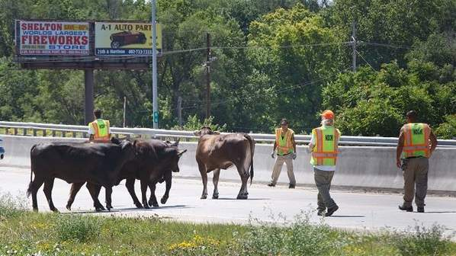
What is a is a traffic incident?
Definition contained in MUTCD Part 6I:
A traffic incident is an emergency road user occurrence, a natural disaster, or other unplanned event that affects or impedes normal flow of traffic.

Slide 9
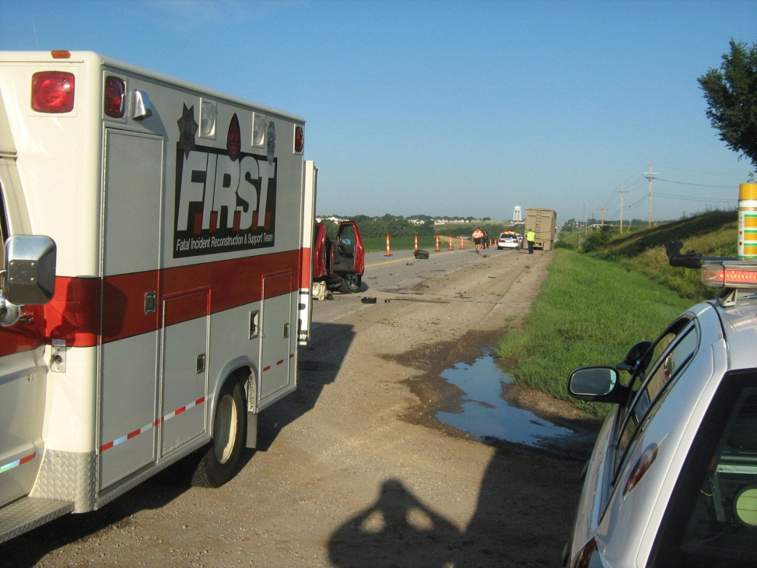
What is Traffic Incident Management?
TIM consists of:
Planned and coordinated multi-disciplinary process to prepare for, mitigate, detect, respond to, and clear traffic incidents so that traffic flow may be restored as safely and quickly as possible.
Effective TIM reduces the duration and impacts of traffic incidents and improves the safety of motorists, crash victims and emergency responders.

Slide 10
What Differences: Rural and Urban Traffic Incident Management?
Mostly the same issues; however…
Remoteness
Golden Hour
Delayed incident detection and response
Long distances
Multi-state corridors
Communications issues
Commercial freight volume
Volunteer Responders
Lack of mass care housing, medical services, food
TIM training opportunities are nights and week ends for rural volunteer responders!

Slide 11
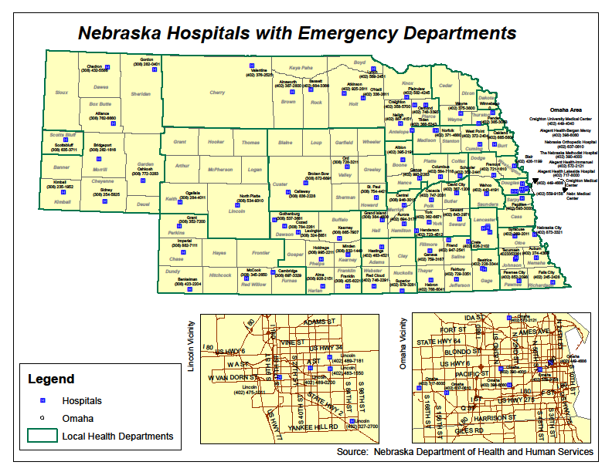
Engineering, Education, Enforcement and EMS
Highway safety professionals have long utilized engineering, education and enforcement approaches.
The 4th “E” –EMS- is less familiar.
Overall risk of death was 25% lower when provided at Level 1 Trauma Center
Counties with coordinated systems for trauma care have rates as much as 50% lower than counties without trauma systems.

Slide 12
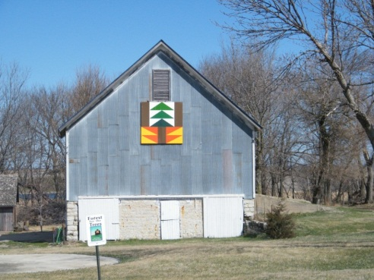
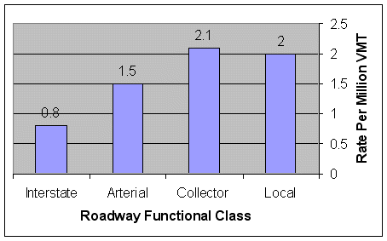
Rural Facts
Changing Traffic Incident Management by Training a Nation of Responders…
23% of the USA population live in rural areas but rural crashes account for 55% of all traffic fatalities
2-lane county roads are the most dangerous
Typical crashes are off-road, 1-car accidents, young victims
Golden Hour: Delayed discovery, stabilization, and transport complicated by long distances

Slide 13
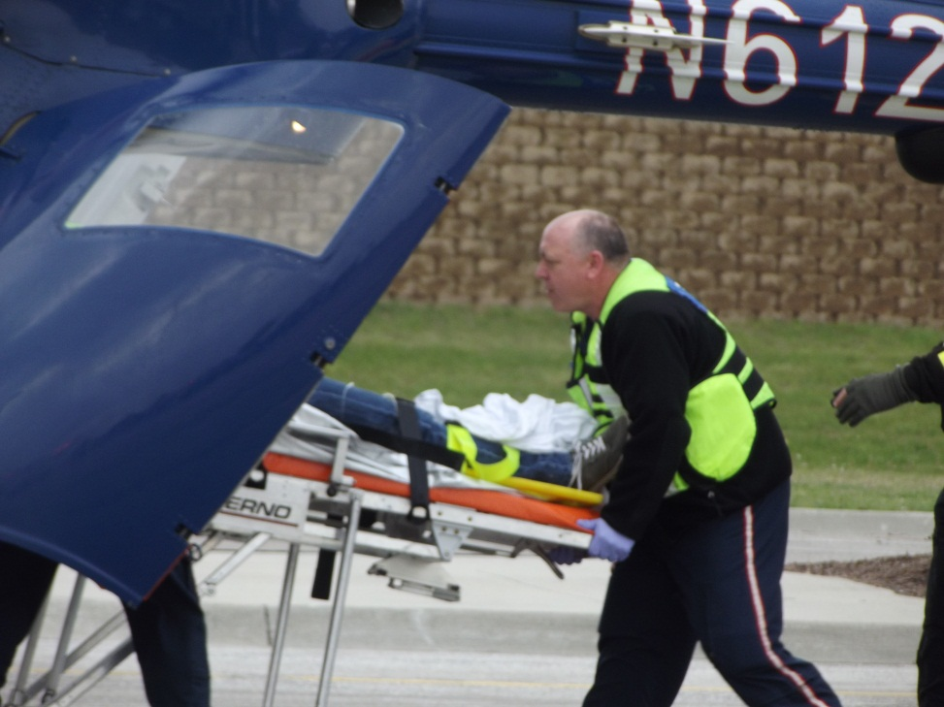
Rural Fact:
The Golden Hour is Critical in Rural America!
Changing Traffic Incident Management by Training a Nation of Responders…
Response time has a well-documented relationship to likelihood of crash survival.
For seriously injured patients, arrival at the hospital within the “golden hour” after the crash is considered a strong predictor of patient outcome.
Notes:
The average notification time [e.g., the time elapsed from the crash or the onset of an emergency until emergency medical service (EMS) is notified] is 5.2 minutes for rural crashes.
The average time between notification and arrival at a fatal crash scene is 11 minutes in rural areas, versus 3.4 minutes in urban areas.

Slide 14


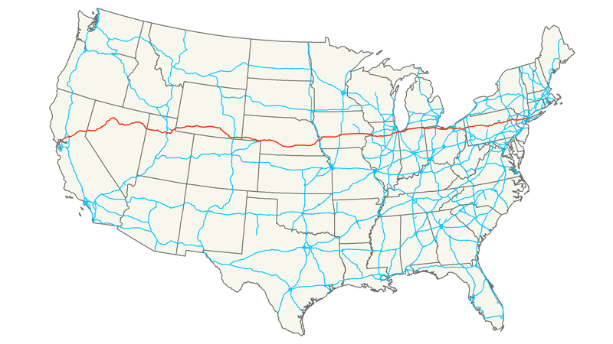

Interstate-80 is Mainly Rural
Western Interstate-80
California: 199 miles
Nevada: 410 miles
Utah: 196 miles
Wyoming: 402 miles
Nebraska: 455 miles
Iowa: 306 miles
www.ndortraveler.mobi

Slide 15


Decision Support Briefing
Highlights
National Weather Service Severe Weather Webinars
What | Where | Timing | Impacts
Severe Weather (Moderate Risk) | Central and Eastern Nebraska, Western Iowa (Mainly north of I-80) | 4 PM to 4 AM | Main Risk is Large Hail and Damaging Winds
Large Hail and Isolated Tornadoes | Central and Northeastern Nebraska | 4 PM to 10 PM | Large Hail greater than 2” Isolated Supercell Tornadoes (5% risk)
Damaging Winds and Heavy Rainfall | Eastern Nebraska and Western Iowa | 4 PM to 4AM (primarily in the evening) | 60 to 80 MPH winds Bow Echo Structure Rain creating flash flooding

Slide 16
Rural Corridor Operations Connect the DOTs
Western I-80 TMCs are hundreds of miles apart in:
Omaha
Cheyenne
Salt Lake City
Reno
Rancho Cordero

Slide 17
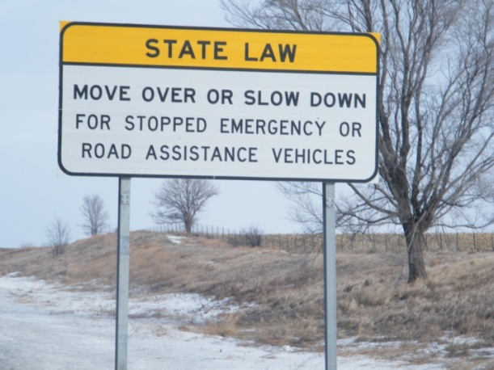
Shortening Incident Duration is Critical in Both Urban and Rural America
Reduces chances of secondary crashes
Reduces responder exposure to danger
Reduces risk
There are 3 Types of Safe, Quick Clearance:
Driver Removal Quick Clearance
Authority Removal Quick Clearance
Move Over/Slow Down Laws

Slide 18
Secondary Crashes
Approximately 20% of all roadway crashes are “secondary” crashes !
Secondary crashes are often worse!
The likelihood of a secondary crash increases for each minute the primary incident continues to be a hazard.
Causes include the dramatic change in traffic conditions, including the spreading of queue length, and the substantial drop in traffic speed, as well as rubbernecking.
Rural incident management programs can prevent secondary incidents by reducing the duration of traffic incidents, and by publicizing the incident using changeable message signs and traveler information systems.

Slide 19
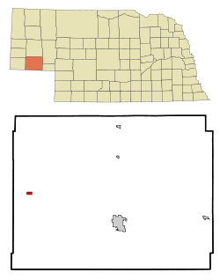

Secondary Crash Kills Maryland Family on Nebraska I-80
September 9, 2012
Cheyenne County Attorney Paul Schaub says a Maryland family riding in separate cars were killed Sunday in the second accident near the Potter interchange on I-80,
The driver of the 2010 Ford Mustang hit by the semi driven by manslaughter suspect was Christopher Schmidt, 30, Gaithersburg, MD.
Schmidt was killed along with his wife and two children, who were in the Toyota Corolla in front of him that was pushed underneath a semi in the fiery crash. They are 28 year old Diana Schmidt, two year old Connor Schmidt and 3 year old Samuel Schmidt.
Authorities say Diana Schmidt was 30 weeks pregnant.
The 36 year old truck driver, from Rivergrove, Illinois, has been charged with multiple counts of manslaughter and motor vehicle homicide stemming from the deaths of the Schmidt family.
The accident occurred when traffic backed up on the interstate for several miles following the fatal collision of two semis in the westbound lanes around 4:20 a.m. near the Potter interchange.
Authorities say the truck driver never slowed down and did not have his CB on where warnings were being issued by truckers about the stalled traffic ahead.
27 year old Keith Johnson of Big Lake, Minnesota, was killed in the first accident.

Slide 20
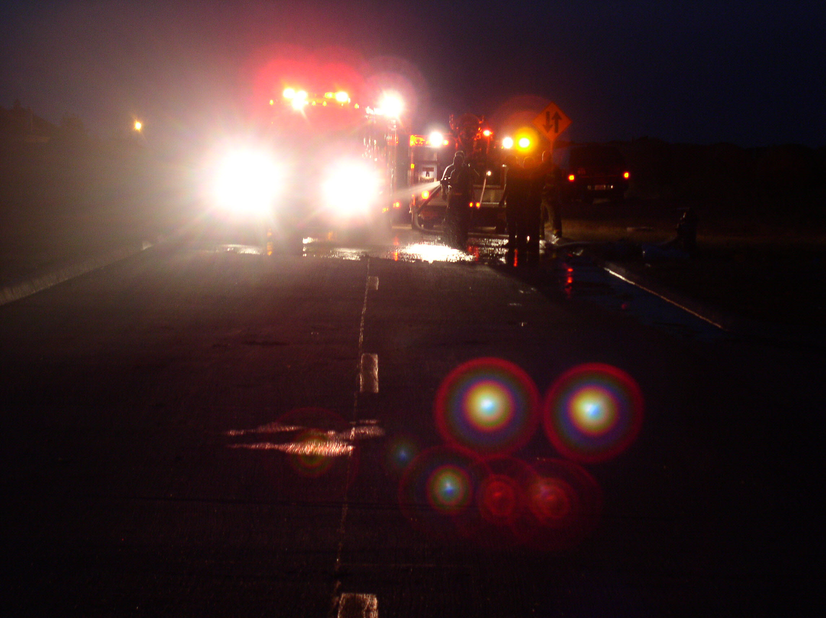
Contributors to Safety Risks and Increased Congestion During Incidents
Careless, inattentive, and impaired drivers
Failure to establish proper TTC devices around the incident scene
Improper positioning of the response vehicle within the Traffic Incident Management Area
Inappropriate response vehicle lighting
Low visibility condition
Lacking situational awareness

Slide 21

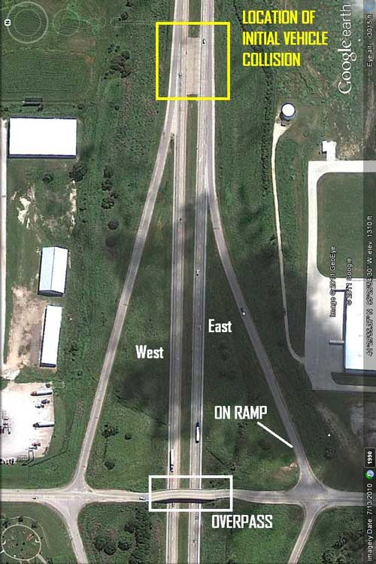
Every Day of the Week…
…there are 38,000 responders on the scene at traffic incidents.
…there are 38,000 responders at risk of serious injury or death.
Scene of firefighter’s death on I-80 in Iowa.
Situational Awareness is critical! Know what is going on around you.

Slide 22
Responders should receive proper training, and have:
adequate staffing
sufficient equipment
appropriate procedures in place for responding to and operating at a roadway emergency incident.
Standard operating guidelines include guidance on identifying and maintaining a safe location while working in or near moving traffic.
Establish pre-incident plans and agreements regarding traffic control incident management at roadway incidents with other public safety agencies…
High-visibility chevrons and reflective markings are applied to all apparatus to enhance conspicuity while parked at emergency scenes and during emergency response.
Motorists should be attentive at all times while operating a motor vehicle, especially when approaching and driving through a traffic incident management area, so that they avoid striking emergency responders, other vehicles, and/or traffic control devices.

Slide 23
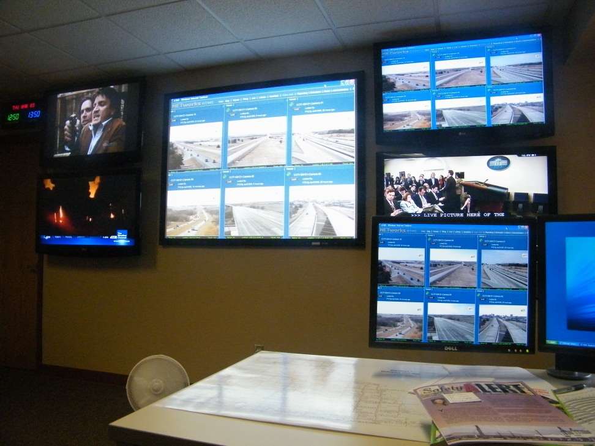
Rural TIM Tools
Intelligent Transportation Systems and Real Time System Management, Rural District Operations Centers
The capability to monitor, in real-time, the traffic and travel conditions of the major highways and to share data with State and local governments and with the traveling public:
Lane blocking events
Road weather
Construction
Travel Time

Slide 24
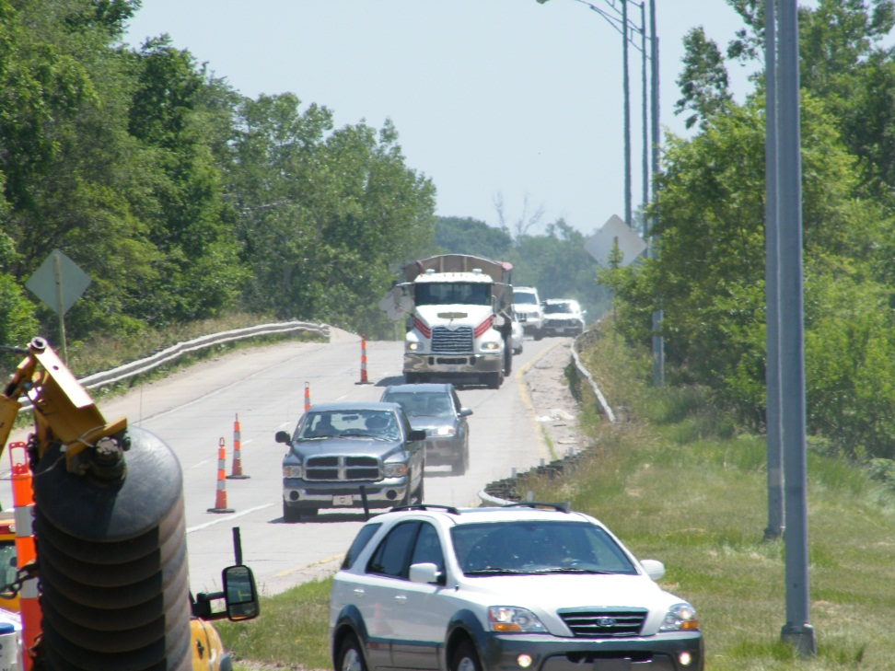
Accident Stages
Motorist Information
Informing road users and establishing a well-defined path to guide road users through the incident area protects the responders and helps in moving road users past or around the incident.
will reduce the likelihood of secondary crashes
will preclude using the local road system.
Your DOT can assist

Slide 25
Incident Command System
Features and Principles
Disciplines
ICS Benefits
Fire and rescue
Law enforcement
Dispatch
Emergency Management Agency
DOT
Towing and recovery
Media
Common terminology
Consistent organizational structure
Consistent position titles
Integrated Communications
Common incident facilities
Roles and Responsibilities

Slide 26
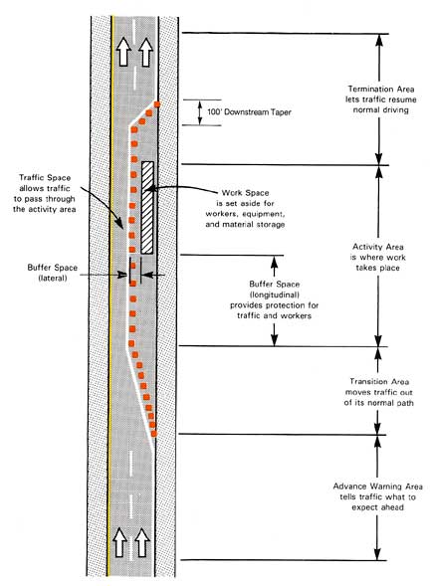
Traffic Incident Management Area
Changing Traffic Incident Management by Training a Nation of Responders…
Advance Warning Area
Transition Area
Buffer Space
Traffic Space
Activity Area
Work Area
Termination Area
Notes:
Section of highway where road users are first informed about the incident area they are approaching.
May vary from a single sign or warning light on a vehicle to a series of warning signs, cones, flares, or emergency vehicles far in advance of the actual incident (crash or any event).

Slide 27
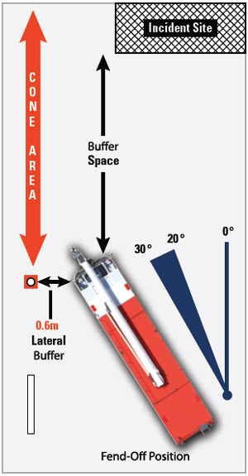
Traffic Control Device
Linear/Block Tactical Positioning
Block Positioning: This means that incident responder vehicles are positioned at angles that create a protected work area for responders and vehicle occupants.
Linear Positioning: This means that incident responder vehicles are positioned in a straight line at the incident scene.

Slide 28
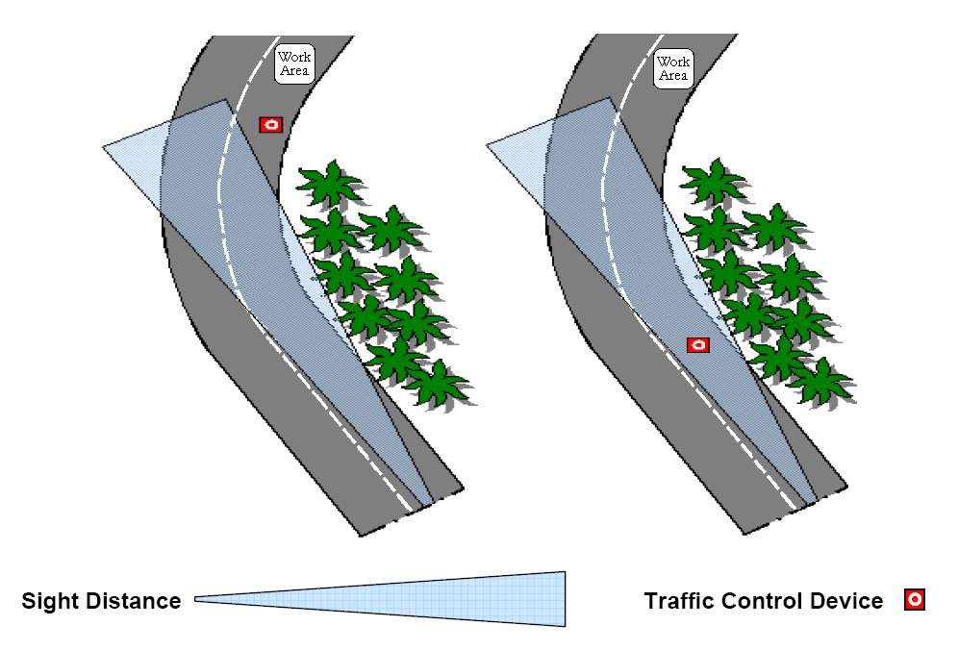
Incorrect
Placement
Correct
Placement
Source: Emergency Traffic Accommodation – A Guide for First Responders
Notes:
Location: in most cases the signs or any advance warning device need to be positioned within the cone of vision of approaching motorists and free of any obstructions that may block the motorist’s vision. This are two examples (incorrect and correct) when you are working near a curve.

Slide 29
Minimize Lights
Avoid glare to motorists
Turn off unnecessary lights
Emergency vehicle lighting:
Provides warning only and provides no effective traffic control
Can be confusing and distracting to drivers
Use amber instead of red

Slide 30
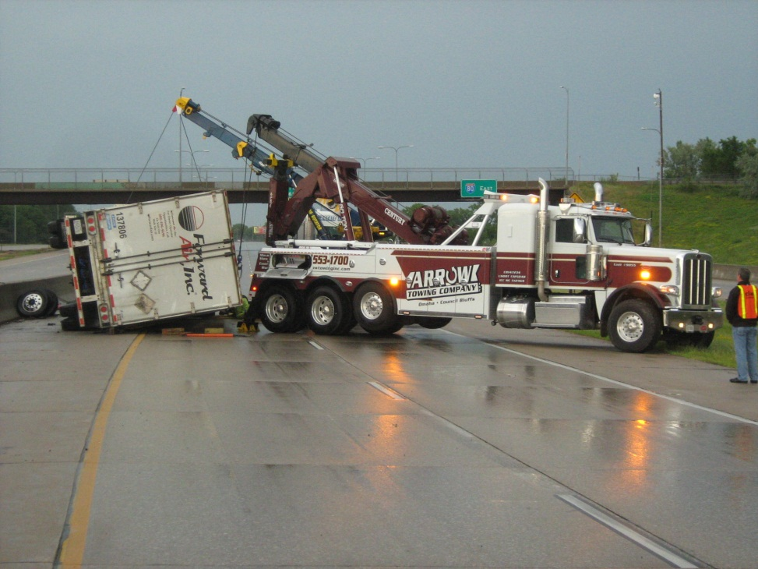
Systematic Re-opening of Travel Lanes
Incident clearance is the process of removing incident debris and fuel spill contents that may hinder the normal traffic flow.
There are 2 types of clearance:
Roadway clearance
Incident scene clearance
The typical order of responder departure is:
EMS
Fire and rescue
Towing and recovery
Law enforcement
NDOR

Slide 31
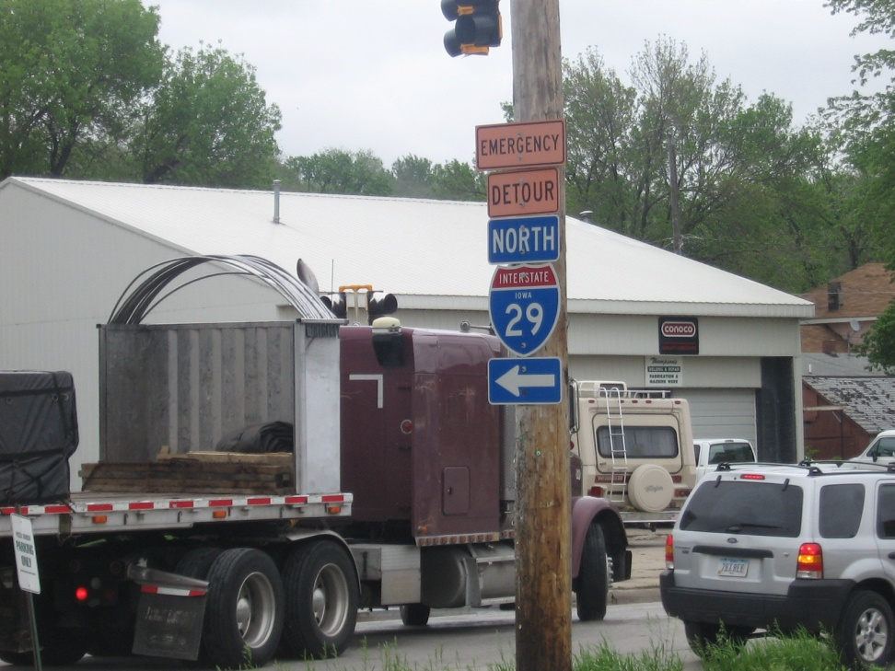
Alternate Routing www.tim.ne.gov

Slide 32
Closing
Better Rural TIM programs & training will result in:
Safe clearance of the Nation’s roadways
Reduction of the risk of death or injury to responders or motorists
Reduction of secondary incidents
Rapid clearance of incidents, reducing the impact on congestion & the potential for secondary crashes
Clearly defined responder roles
Better use of resources
TIM being a “core mission” among transportation, law enforcement & fire/rescue
FHWA serves as the National leader bringing about this vision
Changing Traffic Incident Management by Training a Nation of Responders…

Slide 33
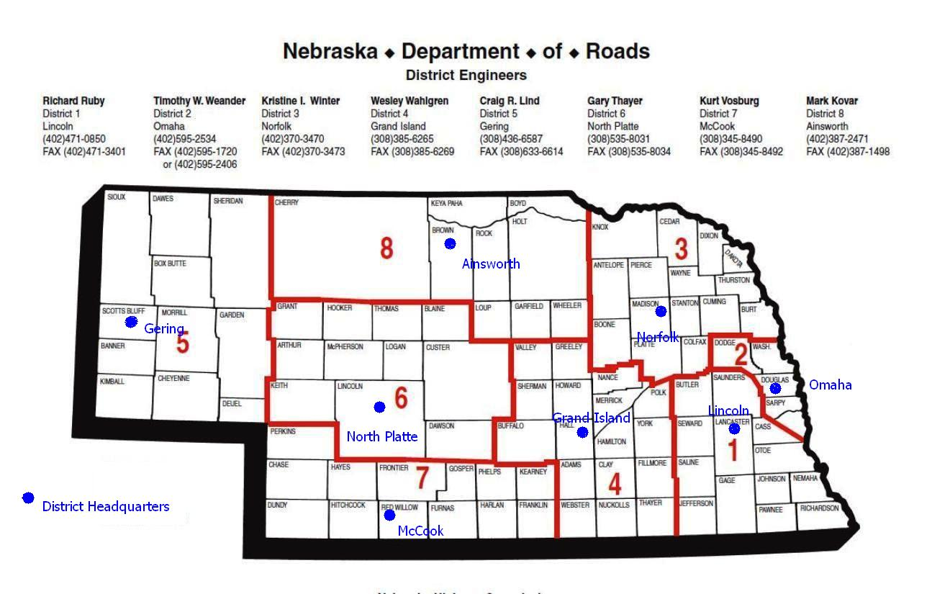
Thank you!
Changing Traffic Incident Management by Training a Nation of Responders…
Jim McGee MPA
Nebraska DOR
Jim.McGee@Nebraska.gov
402-610-0074
www.tim.ne.gov

